Slide 1
Deep Learning
By: Joshua Yap

Slide 2
Part A

Slide 3
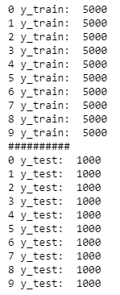
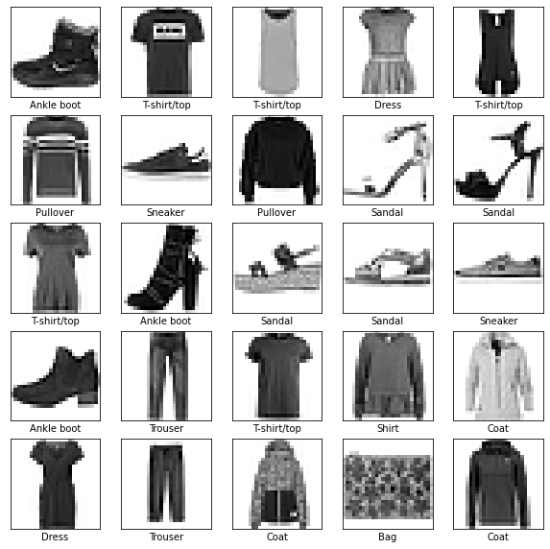
Viewing of Data
Dataset shows black and white photos of various clothing items.
Each picture is stored as a 2x2 array
Each class have the same count

Slide 4
Data Conversion
Data needs to be converted before use.
Normalization of X values and categorising y classes will be done
Code:
from tensorflow.compat.v1.keras.utils import to_categorical
y_train = to_categorical(y_train)
y_test = to_categorical(y_test)
#converting train_X and test_X
#number of pixles
pix=X_train.shape[1] * X_train.shape[2]
X_train = X_train.reshape((X_train.shape[0], pix)).astype('float32')
X_test = X_test.reshape((X_test.shape[0],pix)).astype('float32')
#normalising
X_train = X_train / 255
X_test = X_test / 255

Slide 5
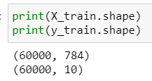
Data Conversion
Data transformed is now a 2d array

Slide 6
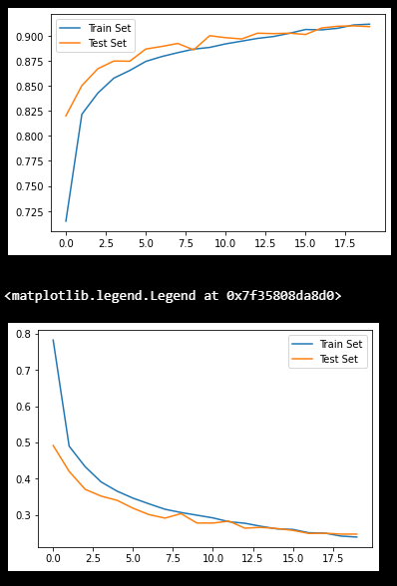
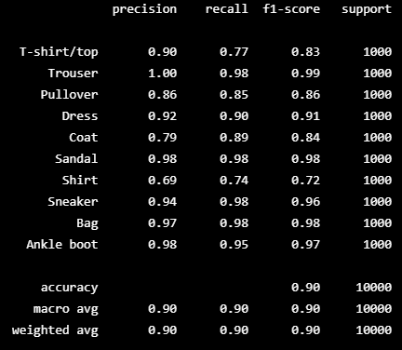
Model building
First, a CNN with a decent complexity will be used.
This will be the base model that will be compared to
Decent error of 9.82%
A Classification Report was made to determine which clothing the model is able to classify most clothing items accurately, and only has problems predicting Shirt.

Slide 7
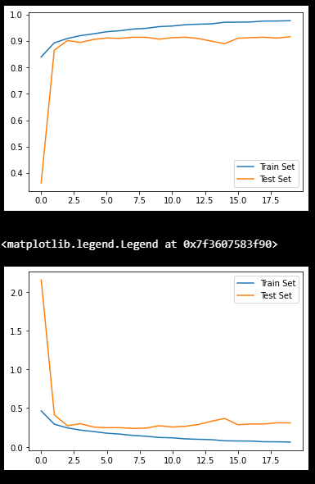
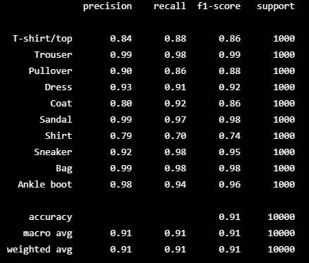
Second Model
A more complex model will be used here. The difference between this and the previous is that batch normalisation occurs between each layer
Adding batch normalisation seems to reduce error, this accuracy has improved to 8.71%.
As loss rate has not intercepted, more epochs could be considered
This model is able to predict some clothing very accurately, but others inaccurately. Possible problems with fit for some items such as coat

Slide 8
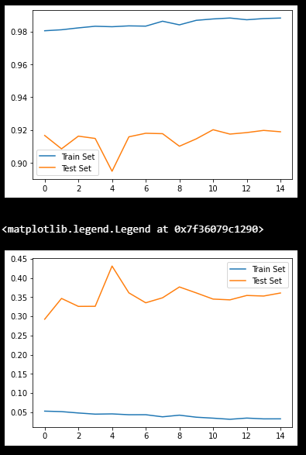
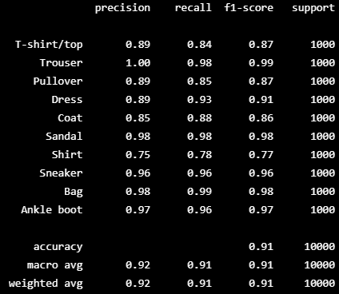
Model 3
Model 3 uses a much higher epoch, at 35.
It seems that the higher epoch has resulted in a lower error rate of 8.52%
The differences in accuracy for either the train or test set is not substantially different
Thus it may not necessarily be overfitted
The mostly similar precision scores for the prediction also implies little overfitting

Slide 9
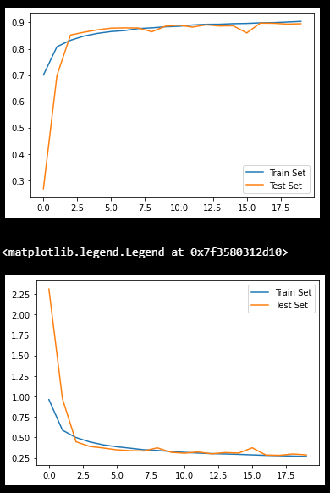

Model 4
Model 4 uses SGD with the optimizer.
Compared to the base model, which uses adam, it seems to have a higher error rate of 10.61%.
Furthermore, the plots show that the accuracy and error have met.
Meaning that higher accuracy may not be possible unless the epochs is increased greatly.
The average precision has also decreased slightly, with precision accuracy for Shirt being the worst

Slide 10
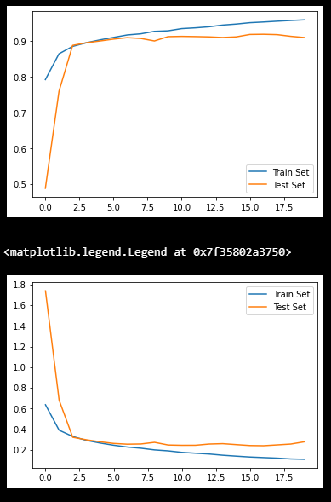
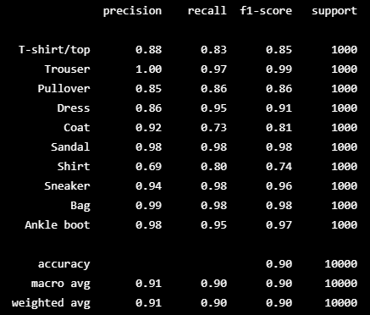
Model 5
Model 5 uses Adamax, which is sometimes considered an improved version of Adam.
Compared to the base Adam, it has lower error rate of 9.59%
Precision for all items seems to be good, except for the Shirt precision
In this context, Adamax may not be a better alternative to Adam. And any improvements may not result in a better error than the Optimized Adam

Slide 11
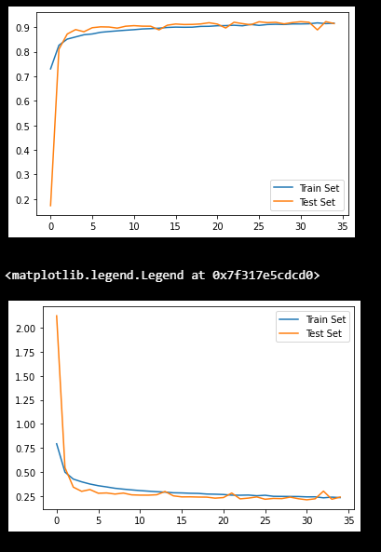
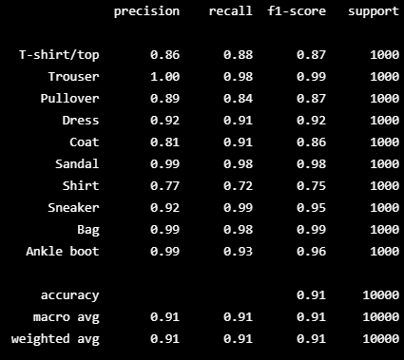
Model 6
Model 6 uses more dropout and batch normalization layers.
Dropout is set to 0.4, epochs of 35 and batch size of 200
It is able to predict most classes well, with the exception of shirt, and has a the lowest error rate of 8.69%
The loss also seems to have converged

Slide 12
Conclusion
Model 5 will be used.
This is because it is the best mix of low loss and precision.
The prediction scores also do not vary across an extremely wide range
It also does not seem to be substantially overfitted and loss has converged

Slide 13

Part B

Slide 14
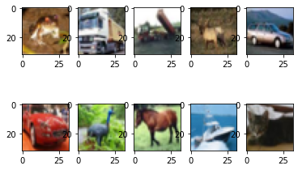
Viewing of dataset
The data set contains colour, and is of various items, ranging from animals to vehicles.
The count for each class is the same

Slide 15
Feature Engineering
Using this code, X_train and X_test values are normalised, and y_train and y_values are encoded.
X_train=X_train.astype('float32')/255
X_test=X_test.astype('float32')/255
from tensorflow.compat.v1.keras.utils import to_categorical
y_train=to_categorical(y_train)
y_test=to_categorical(y_test)

Slide 16
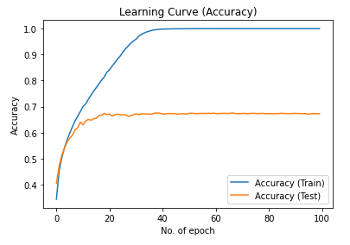
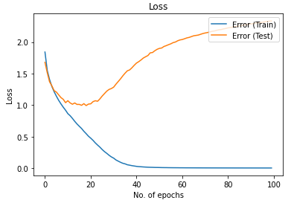
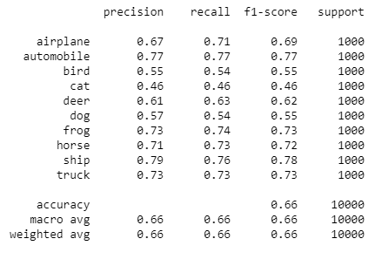
Model 1
Model 1 is a generic model.
It contains 3 layers of Conv2d, incrementally increasing the kernel size until it matches the first dense layer.
It has an error of on test set of 33.94%
As the learning curve for the test set flattens at around 10 epochs, but loss for test continually increases after each epoch, it is possible that there is overfitting of the train data has occurred
It is quite imprecise in predicting the picture, being particularly bad at predicting if something is a cat

Slide 17
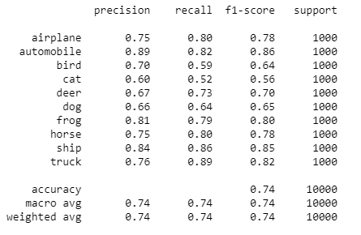
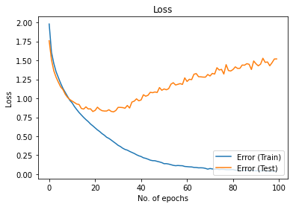
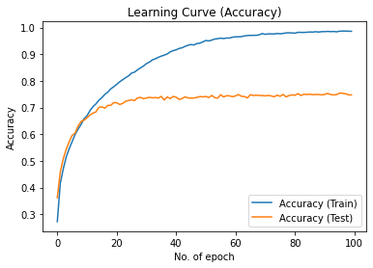
Model 2 (Simpilified VGG)
VGG is a type of CNN made for image classification, it was proposed by K. Simonyan and A. Zisserman.
A modified version will be used here, with increasing conv2d kernel size
3 layers of 2 sets of conv2d, followed by a dropout of 0.2 was added/modified from the previous model.
Error has now decreased to 25.58%
Model still shows some level of overfitting.
However, error on test set did not increase as drastically as before
Precision for all classes have also increased to be more accurate than before
More improvements will need to be made

Slide 18
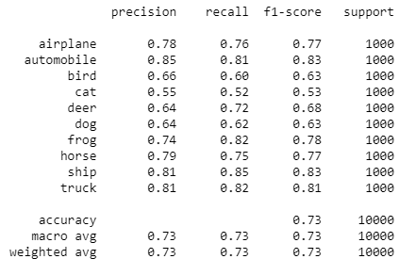
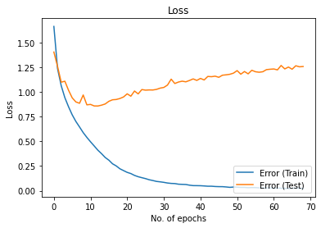
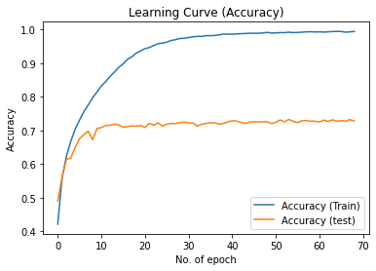
Model 3 (BatchNormalization)
Batch normalisation will be added in between each layer
Although error has increased to 27.27%, the loss has not increased more drastically than the previous model. Thus, some improvement on the overfitting has been made.
Average precision has gone down slightly, but all classes are generally predicted fairly well

Slide 19
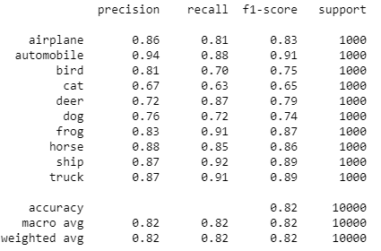
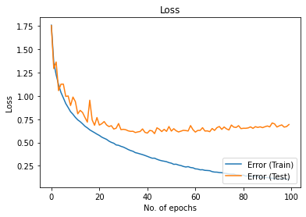
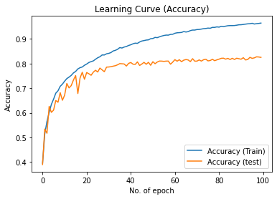
Model 4
Further layers of dropout of 0.2 will be added to help with overfitting
New error is now 18.10%
As the loss does not increase but remains nearly constant, over fitting is not as great of an issue currently
Precision has improved, but like before, the model has problems predicting for the class ‘cat’

Slide 20
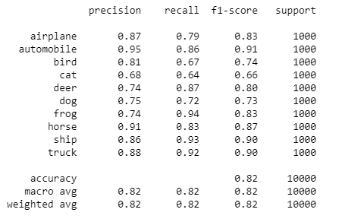
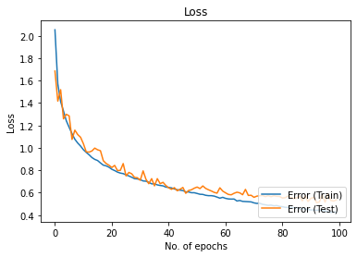
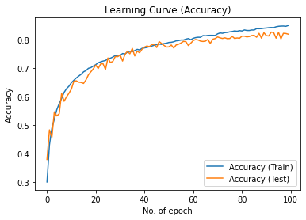
Model 5
Final model uses incrementally increasing values of dropout.
Error has increased to 18.33%.
This is the second-best model constructed during this project in terms of accuracy.
Problems of overfitting does not seem to be as prevalent in this model and the training and validation loss are close to converging.
Precision is mostly not an issue, apart form the deer class

Slide 21

Conclusion
Model 5 will be used as it does not seem to be greatly overfitted and has a relatively low error score.
Its precision for predicting the test set is decently good, only have problems predicting cat and dogs which other models also have problems with

